Slide 1


Institute of Technology of Cambodia
Department: AMS
Lecturer: Sokkhey Phauk
Presented by :
1. NGOUN LYHORNG e20220472
2. NY CHANTHARITH e20221532
3. PHAN WAYOTEP e20220850
4. SAMBATH SEAKTY e20220517
5. SOEUK BONDOL e20221592

Slide 2
Abstract
Institute of Technology of Cambodia
Department: AMS
Water Quality Prediction: A Data-Driven Approach
The use of data science to predict water quality and ensure the safety and sustainability of our precious water resources.
Presented by :
1. NGEN TINA e20221516
2. NEANG VANNA e20221650
3. PHAN WAYOTEP e20220850
4. SOEUK BONDOL e20221592
5. SOPHAT VITOU e20220813
Lecturer: Sokkhey Phauk

Slide 3

Water Quality
Water quality is vital for human health, ecosystems, and economic development. Monitoring and predicting water quality changes are crucial for effective water resource management.
Abstract
Data Science
Powerful tools to analyze large datasets and generate predictive models. Machine learning algorithms can analyze vast amounts of water data to identify trends, predict future conditions, and support decision-making.
Water quality prediction is a critical task for environmental monitoring and resource management. Data-driven models, leveraging various techniques like machine learning, offer valuable insights into water quality trends and future scenarios.
This presentation outlines a comprehensive approach to water quality prediction, including data collection, data analysis, model construction, evaluation, and future directions.
Predictive Modeling
Forecasting water quality trends and potential threats. Timely intervention for proactive protection and management.

Slide 4
Introduction
Water Quality
Data Science
Water quality is vital for human health, ecosystems, and economic development. Monitoring and predicting water quality changes are crucial for effective water resource management.
Powerful tools to analyze large datasets and generate predictive models. Machine learning algorithms can analyze vast amounts of water data to identify trends, predict future conditions, and support decision-making.
Predictive Modeling
Forecasting water quality trends and potential threats. Timely intervention for proactive protection and management.

Slide 5
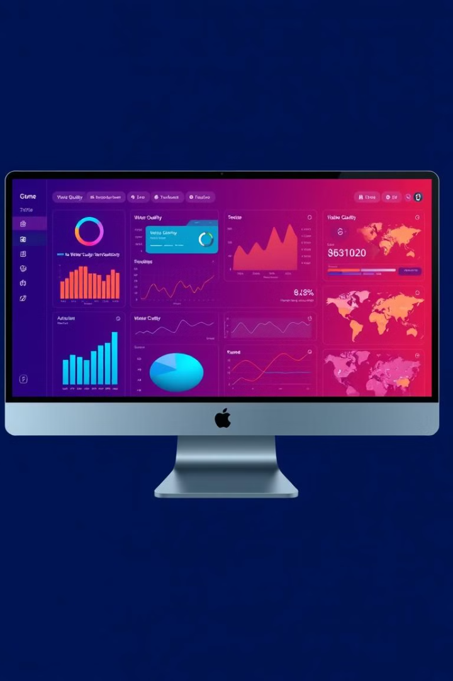

Exploring Data Analysis
Data Collection
Methodology
Water quality data is from Kaggle that collected from various sources, including monitoring stations, remote sensing, and citizen science al around the world.
Water Quality Prediction

Slide 6




Model Construction
Exploring Data Analysis
Data Cleaning
Data Visualization
Handling missing values, outliers, duplicated data and correct inconsistencies in the data. Ensuring data accuracy and reliability.
Identifying patterns, trends, and relationships within the data. Understanding the key drivers of water quality.
Summary Statistics
Data Training
Calculate descriptive statistics, such as mean, median, and standard deviation, to gain insights into the data distribution.
Splitting the data into training and testing sets. Training the model (many way which one is the best) to learn from historical data.
Random Forest
Logistic Regression
Support Vector classifier
Decision Tree
Combines multiple decision
trees to improve prediction accuracy and reduce variance.
Uses a logistic (sigmoid) function to model the probability of a binary or multi-class outcome, making predictions based on a linear combination of input features.
Separates data points into different classes by finding the optimal hyperplane that maximizes the margin (distance) between data points of different classes.
Uses a tree-like structure to make predictions based on a series of decisions.

Slide 7
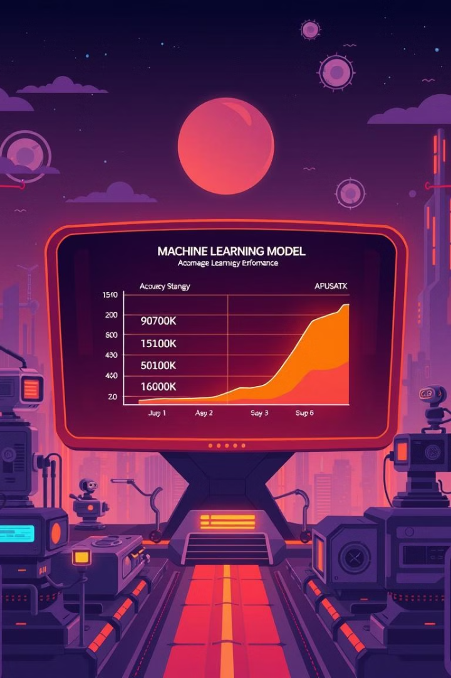
Model Construction
Random Forest
Logistic Regression
Support Vector classifier
Decision Tree
Combines multiple decision
trees to improve prediction accuracy and reduce variance.
Uses a logistic (sigmoid) function to model the probability of a binary or multi-class outcome, making predictions based on a linear combination of input features.
Separates data points into different classes by finding the optimal hyperplane that maximizes the margin (distance) between data points of different classes.
Uses a tree-like structure to make predictions based on a series of decisions.

Slide 8
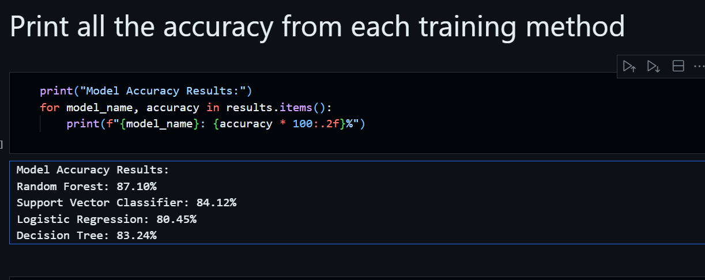
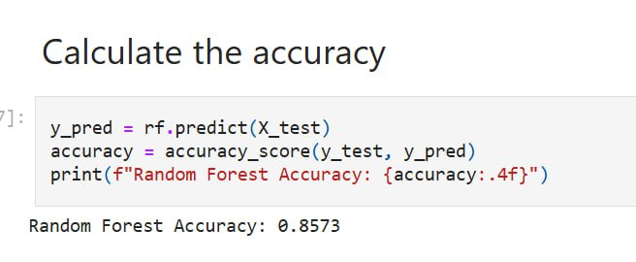
Evaluation
1
Model Performance
Assess the model's accuracy to evaluate its predictive power.
2
Comparison of Models with accuracy
Split the data into training and testing sets to ensure the model's generalizability and prevent overfitting.
Compare the performance of different models and choose the best-performing model for water quality prediction.

Slide 9

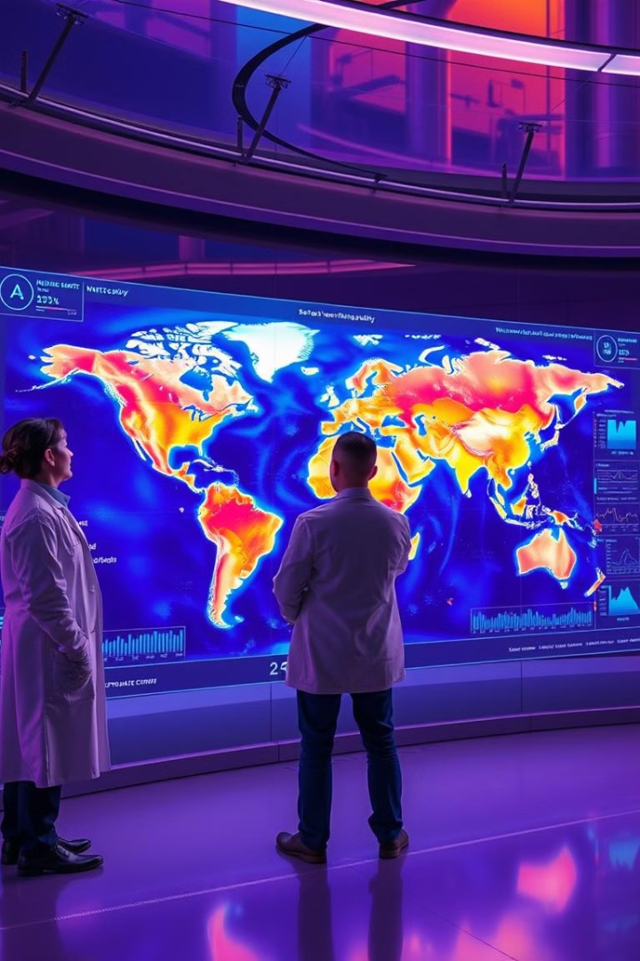
Interpreting Predictive Insights
1
Temporal Trends
Predicting water quality with unseen data.
2
Impact Assessment
Evaluating the potential impact of human activities on water quality.

Slide 10



Conclusion
Key Findings
Summarize the key results and insights from the water quality prediction study.
Future Directions
Explore opportunities for further research, including incorporating new data sources, improving model accuracy, and developing real-time prediction systems.

Slide 11
Reference
GitHub:
chantharith-NY/data-science-project
Kaggle:
Water Quality Prediction

Slide 12



Slide 13

Any question:

